Slide 1

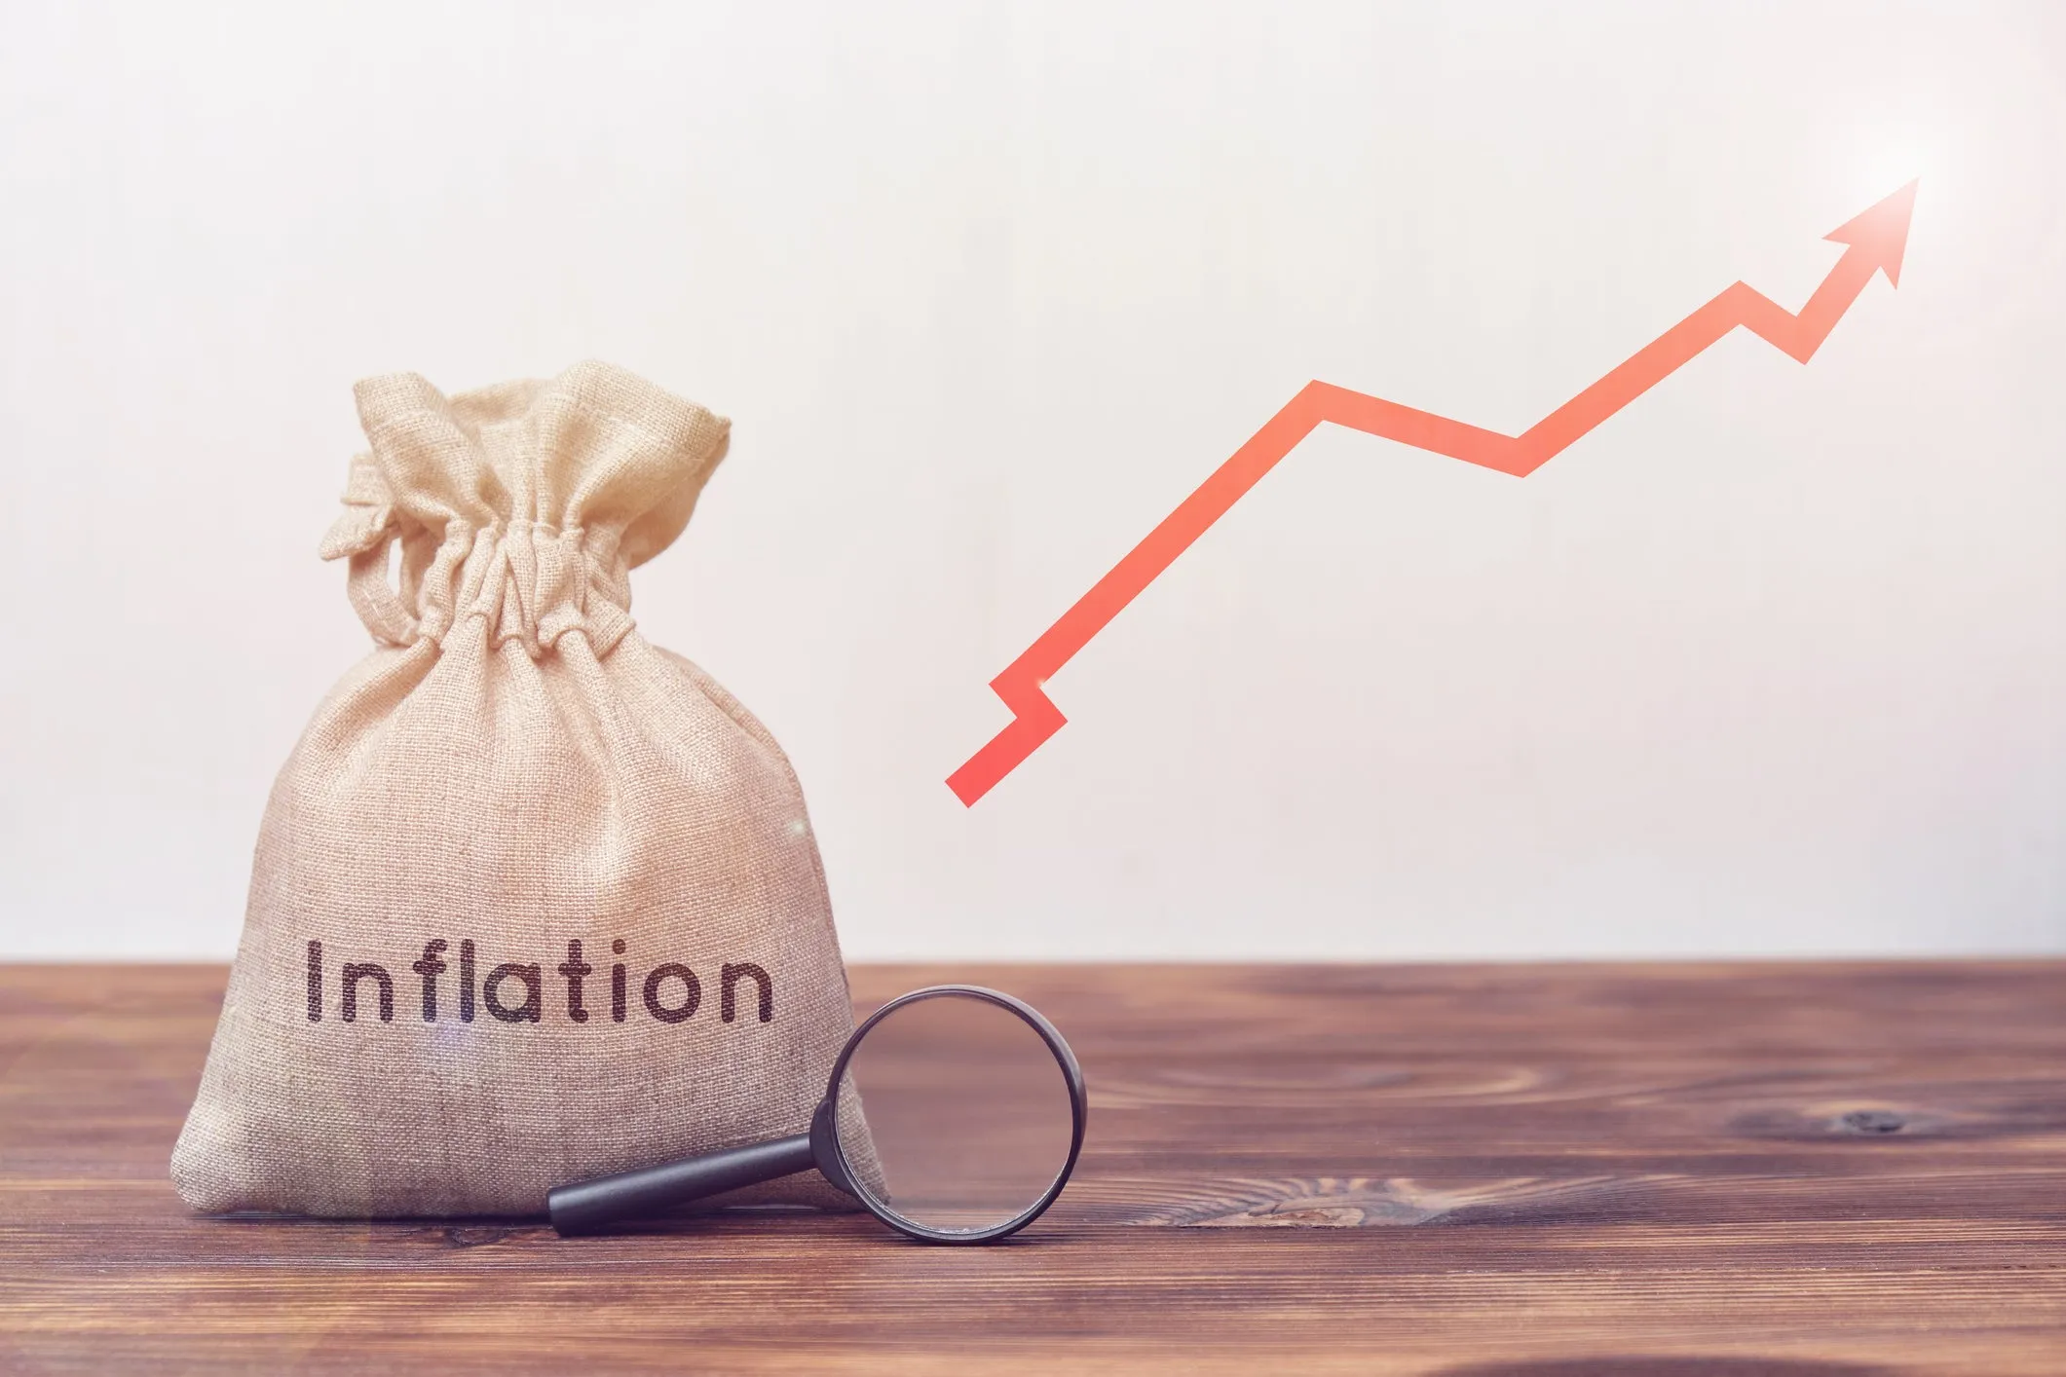
INFLATION

Slide 2

Overview
What is Inflation?
Causes of Inflation
Effects of Inflation
Types of inflation
Is Inflation is bad for Everyone?
Conclusion

Slide 3
What is Inflation
Inflation refers to increase in price of goods and services over a given period of time such as food, clothing, housing etc.
The fall in price of goods and services called Deflation.
The inflation rate is the percentage increase or decrease in prices during specified period.
The current inflation rate in India is 7.04%.

Slide 4
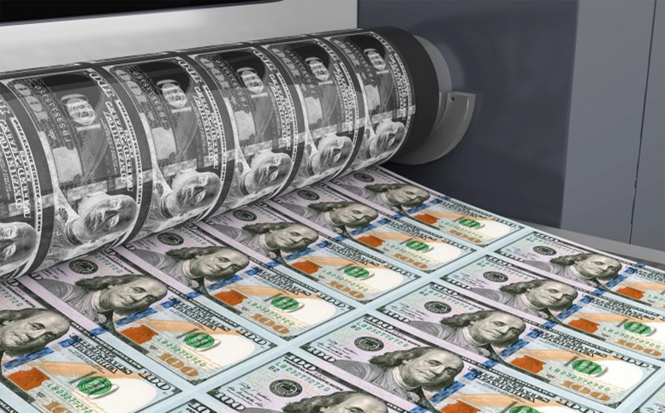
Causes Of Inflation
1)Currency inflation:
This type of inflation is caused by the printing of currency notes.

Slide 5
Causes Of Inflation
2) Demand-Pull Inflation:
The prices of certain goods and services rise as their demand gets increases.

Slide 6
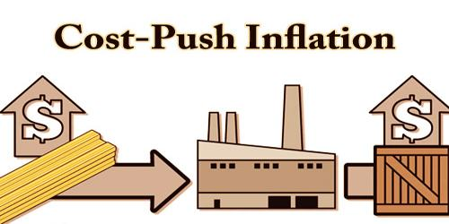
Causes Of Inflation
3) Cost-push inflation:
The price of the finished product directly depends upon the cost involved in its production for example if the production cost is less then the price of the product will be less and vice versa.
As per the recent data the inflation rate in India in the first quarter has reached above 7.79%.

Slide 7

Effects of Inflation
As the prices rise, every single dollar has less and less purchasing power because more dollars are necessary to buy same goods or services.
It impacts on the cost of living in a country, when inflation Is high, the cost of living gets higher as well which leads to decrease in Economic growth.
However, a healthy inflation rate (2-3%) is considered positive because it directly results in increasing wages and maintains capital flowing in a growing economy.

Slide 8
Is Inflation is bad for Everyone?
Not everyone suffers a loss due to inflation, there are many who get profited from it and mainly the investors and stakeholders.
Investors – Investors enjoy a great profit due to inflation as the price of their assets and investments multiplies with an increase in the rate of inflation. For example, for an investor who has bought some precious metal or a piece of land years back, at present its rate has been multiplied significantly.
Share Holders – It’s a usual trend in the stock market that the prices of stocks go up with the time and thus as the rate of inflation increases the prices of the stocks also increase thus generating a decent profit for the shareholders.

Slide 9
Who And How to measures inflation in India?
The Ministry of Statistics and Programme Implementation(MOSPI) Measures the inflation in india.
Price index level:-
Expresses the level of prices of goods traded in economy at the same time Price index is calculated for particular market basket for examined periods.

Slide 10
How to measure inflation?
CPI
Consumer price index:-
The most often used index
Measures the price of a selection of goods purchased by a "typical consumer".
It is a statistical time-series measure of a weighted average of prices of a specified set of goods and services purchased by consumers.
It is a price index that tracks the prices of a specified basket of consumer goods and services, providing a measure of inflation.

Slide 11
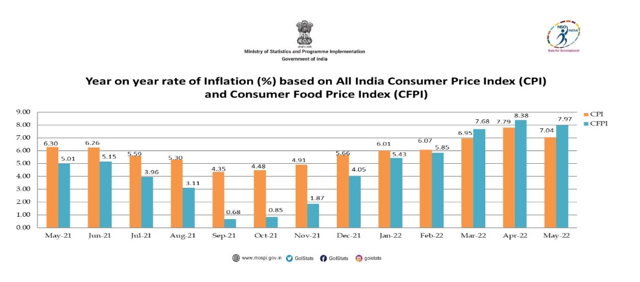
CPI Graph

Slide 12
How to Controlling inflation?
Two ways of controlling:-1)Monetary measures
2)Fiscal measures
1)Monetary measures:-Commonly used method to control inflation is monetary policy of central banks. Most central bank use high interest rates to fight or prevent inflation.
2)Fiscal measures to control inflation include taxation, government expenditure and public borrowings.

Slide 13
Conclusion
A reasonable rate of inflation of around 3- 6 per cent is often viewed to have positive effects on the national economy as it encourages investment and production and allows growth in wages. When inflation crosses reasonable limits, it has negative effects. It reduces the value of money, resulting in uncertainty of the value of gains and losses of borrowers, lenders, and buyers and sellers.

Slide 14

Thank you and Q&A
Presented by :Sachin Mittalkod

